Slide 1
Binary Numbers
Computer Addressing

Slide 2
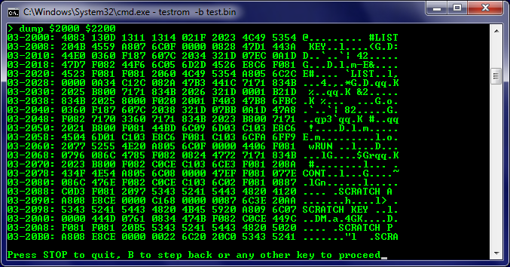

Slide 3
Number Systems Used in Computers
Decimal System (Base 10)
Digits: 0,1,2,3,4,5,6,7,8,9
Used for communicating with human users
Binary System (Base 2)
Digits: 0,1 (Off or On)
Binary 10 == Decimal 2
Used by internal CPU and Memory circuits
Octal System (Base 8)
Digits: 0,1,2,3,4,5,6,7 (No digits 8 & 9)
Octal 10 == Decimal 8
Used by Computer Scientists for groupings of 3 binary digits
Hexadecimal System (Base 16)
Digits: 0,1,2,3,4,5,6,7,8,9, A, B, C, D, E, F (Uses extra letters)
Hex F == Decimal 15
Hex 10 == Decimal 16
Used by Computer Scientists for groupings of 4 binary digits

Slide 4
Decimal vs. Binary System
Decimal System
Uses Digits:
0, 1, 2, 3, 4, 5, 6, 7 , 8, 9
Addition
0 + 1 = 1
1 + 1 = 2
99 + 1 = 100
Powers of 10
10⁰ = 1
10¹ = 10
10² = 100
Etc.
Evaluate 111
111 = 10² + 10¹ + 10⁰
(100 + 10 + 1)
Binary System
Uses Digits:
0, 1 (True, False) (+, -)
Addition
0 + 1 = 1
1 + 1 = 10
11 + 1 = 100
Powers of 2
2⁰ = 1
2¹ = 10 (or 2 decimal)
2² = 100 (or 4 decimal)
Etc.
Evaluate 111
111 = 2² + 2¹ + 2⁰
(Decimal : 4 + 2 + 1 = 7)
Definition: 1 Bit = 1 Binary Digit

Slide 5
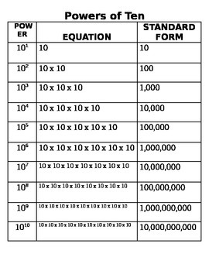
Base 10
Evaluate 111
In Decimal
 | 100 | 10² | 100
+ | 10 | 10¹ | + 10
+ | 1 | 10⁰ | + 1
= | 111 |  | = 111

Slide 6
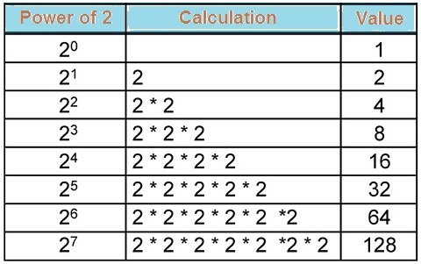
Base 2
Binary
1
10
100
1000
Evaluate 111
In Binary
 | 100 | 2² | 4
+ | 10 | 2¹ | + 2
+ | 1 | 2⁰ | + 1
= | 111 |  | = 7

Slide 7
Power of 2 | Decimal Value | Integer Range | Number of Bits | Computer Binary
2¹ | 2 | 0 - 1 | 1 | 0001
2² | 4 | 0 - 3 | 2 | 0011
2³ |  |  |  | 0111
2⁴ |  |  |  | 1111
2⁵ |  |  |  | 0001 1111
2⁶ |  |  |  | 0011 1111
2⁷ |  |  |  | 0111 1111
2⁸ | 256 | 0 - 255 | 8 | 1111 1111
2⁹ |  |  |  | 0001 1111 1111
2¹⁰ |  |  |  | 0011 1111 1111
2¹¹ |  |  |  | 0111 1111 1111
2¹² |  |  |  | 1111 1111 1111
2¹³ |  |  |  | 0001 1111 1111 1111
2¹⁴ |  |  |  | 0011 1111 1111 1111
2¹⁵ |  |  |  | 0111 1111 1111 1111
2¹⁶ | 65,536 | 0 – 65,535 | 16 | 1111 1111 1111 1111

Slide 8
Power of 2 | Decimal Value | Integer Range | Number of Bits | Computer Binary
2¹ | 2 | 0 - 1 | 1 | 0001
2² | 4 | 0 - 3 | 2 | 0011
2³ | 8 | 0 - 7 | 3 | 0111
2⁴ | 16 | 0 - 15 | 4 | 1111
2⁵ | 32 | 0 - 31 | 5 | 0001 1111
2⁶ | 64 |  | 6 | 0011 1111
2⁷ | 128 |  | 7 | 0111 1111
2⁸ | 256 | 0 - 255 | 8 | 1111 1111
2⁹ | 512 |  |  | 0001 1111 1111
2¹⁰ | 1024 |  |  | 0011 1111 1111
2¹¹ | 2048 |  |  | 0111 1111 1111
2¹² | 4096 |  |  | 1111 1111 1111
2¹³ | 8192 |  |  | 0001 1111 1111 1111
2¹⁴ | 16384 |  |  | 0011 1111 1111 1111
2¹⁵ | 32768 |  |  | 0111 1111 1111 1111
2¹⁶ | 65,536 | 0 – 65,535 | 16 | 1111 1111 1111 1111

Slide 9
Binary Conversions
Convert the following binary numbers to decimal:
11 binary =
101 binary =
1010 binary =
Convert the following decimal numbers to binary:
6 decimal =
13 decimal =

Slide 10
Binary Conversions
Convert the following binary numbers to decimal:
11 binary = 3 decimal (i.e. 2 + 1)
101 binary = 5 decimal (i.e. 4 + 1)
1010 binary = 10 decimal (i.e. 8 + 2)
Convert the following decimal numbers to binary:
6 decimal = 110 binary (i.e. 4 + 2)
13 decimal = 1101 binary (i.e. 8 + 4 + 1)

Slide 11
Binary Addition
Add the following binary numbers (verify your answers using decimal)
a) | 0101 | (decimal 5) |  | b) | 0101 | (decimal 5)
 | + 0010 | (decimal 2) |  |  | + 1010 | (decimal 10)
c) | 0011 | (decimal 3) |  | d) | 0110 | (decimal 6)
 | + 0010 | (decimal 2) |  |  | + 0011 | (decimal 3)

Slide 12
Binary Addition
Add the following binary numbers (verify your answers using decimal)
a) | 0101 | (decimal 5) |  | b) | 0101 | (decimal 5)
 | + 0010 | (decimal 2) |  |  | + 1010 | (decimal 10)
 | 0111 |  |  |  | 1111
c) | 0011 | (decimal 3) |  | d) | 0110 | (decimal 6)
 | + 0010 | (decimal 2) |  |  | + 0011 | (decimal 3)
 | 0101 |  |  |  | 1001

Slide 13
Computer Memory

Slide 14
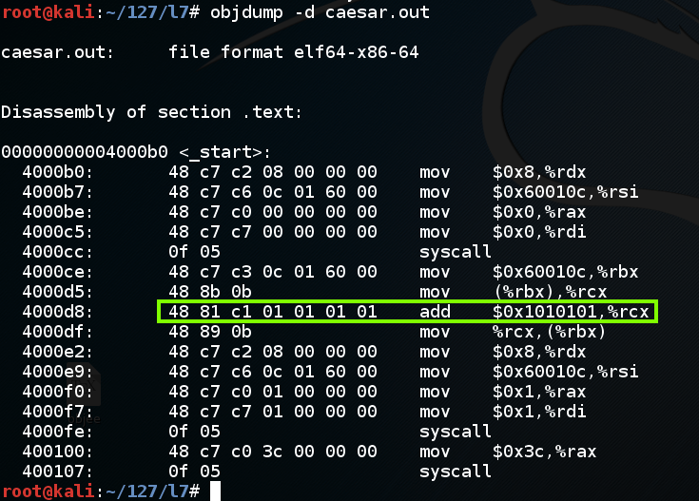

Slide 15
Prefixes
Kilo (K) means __________________ Multiply by x______________
Mega (M) means _________________ Multiply by x______________
Giga (G) means __________________ Multiply by x______________
Tera (T) means __________________ Multiply by x______________

Slide 16
Prefixes
Kilo (K) means ___Thousand_______ Multiply by x__1,000_______
Mega (M) means __Million________ Multiply by x__1,000,000___
Giga (G) means ___Billion________ Multiply by x __1,000,000,000___
Tera (T) means ___Trillion________ Multiply by x __1,000,000,000,000___

Slide 17
Examples
64 Mbps (Mega-bits per seconds) = ________________ bps (bits per second)
256 Giga-bytes = ________________ bytes
256 Giga-bytes = ________________ bits

Slide 18
Examples
64 Mbps (Mega-bits per seconds) = __64,000,000______ bps (bits per second)
256 Giga-bytes = __256,000,000,000___ bytes
256 Giga-bytes = __2,048,000,000,000___ bits

Slide 19
Computer Memory Structures
Bit
1 binary digit
Used for Boolean data type
Building Block for All computer data and memory
Byte
8 binary digits
Largest value: 1111 1111 (2⁸ – 1 = 255 Decimal)
Used for Char (character) data type
26 lower case letters + 26 uppercase letters + 10 number symbols + punctuation marks+ Other Stuff equal about 130 distinct characters

Slide 20
Computer Memory Structures
Word
16 binary digits (2 bytes)
Largest value: 1111 1111 1111 1111 (2¹⁶ – 1 = 65,535 Decimal)
Integer data type (Short)
Is 1 Word (16 bits)
But must represent both Positive (+) and Negative (-)
Range: +32767 to -32768
Larger or smaller numbers require a different data type

Slide 21
Computer Memory Structures
Double Word
32 binary digits (4 bytes or 2 words)
Largest value: 2³² – 1 = 4 billion approx)
Integer data type (Long)
Provides much larger range than Integer for Positive (+) and Negative (-) numbers
Double Word Memory Addressing
Provides access to about 4 GB of memory max.

Slide 22
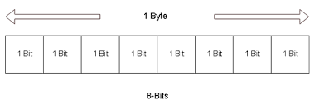
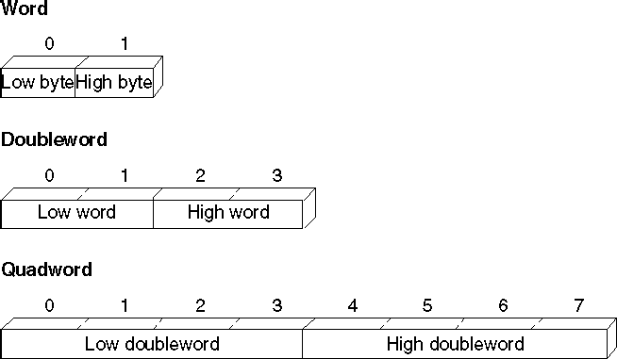

Slide 23
Research Questions
6 Questions
Download from GitHub
Answer & Upload

Slide 24
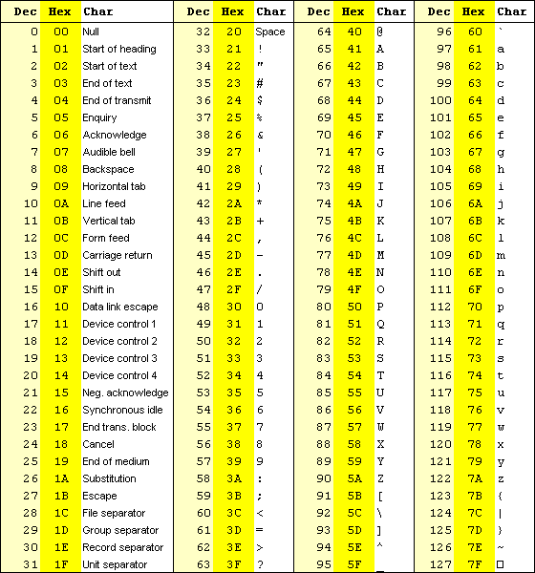
ASCII Character Codes

